Slide 1
Smart ABC Learning System Using Finger Gestures
Name of Mentor – Dr. Anjali Anand
Anmol Dhawan - 101610010
Ankit Sinha - 101783048
Ankur Sharma - 101603043
Ankush Karara - 101603044
CPG Number - 12

Slide 2
Table of Content
Slide No. | Content
3 | Background of project
4 | Scope and utility
5 | Objectives
6 | Methdology
7 | Constraints and Assumptions
8 | Standards to be used
9 | Architecture of the project
10 | Techniques and tools used
11 | Professional and technical learning
12-13 | Insight into working of project
14 | Key highlights

Slide 3
Background of Project and Existing Work
Our project mainly deals with the object tracking and deep learning. It mainly uses the Convolution Neural networks for recognizing the alphabets. It also contains the facility of vocal learning.
Researches have been going on object tracking in order to achieve more effective accuracy.

Slide 4
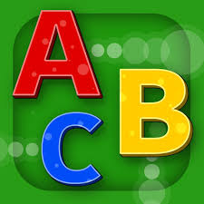
Scope and Utility of the project
Our project mainly evolves around the effective learning of English alphabets writing for children in a smart way using finger gestures.
This is futuristic way of learning which would help children to inculcate the habit of interactive learning.

Slide 5
Objectives
The main objective of this project is to help the children to effectively learn the English alphabets and their pronunciation.
It also aims to inculcates the habit of interactive and smart learning among children with the help of technology.
Since, the learning is based on finger gestures. So, that will also be a fun and interesting way of learning which would help them in effective understanding.

Slide 6
Methodology
Finger gestures will be used to draw alphabet on screen.
We are going to use object tracking using webcam for finger gestures to work. Some object(say a small ball on a ring) will be placed on child finger.
Alphabet drawn on screen will be recognized using Deep Learning.
To make it more effective, an image corresponding to the recognized alphabet is displayed and corresponding audio file will be played so that child will learn how to pronounce that letter.

Slide 7
Constraints and Assumptions
We assume the children that will be learning from our project are of age falling in the range of 2.5-4 yrs.
At one time, our project can detect only one alphabet. No word i.e., combination of 2 or more alphabets can not be given as input.

Slide 8

Standards to be used
We are using Letter Recognition Data Set from UCI machine learning repository in our project.
We are using open CV library for object detection.

Slide 9
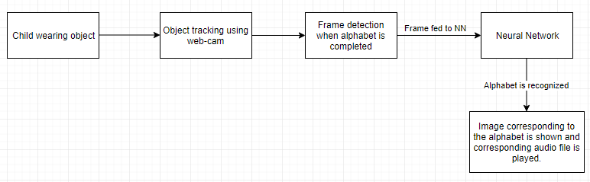
Architecture of the project

Slide 10
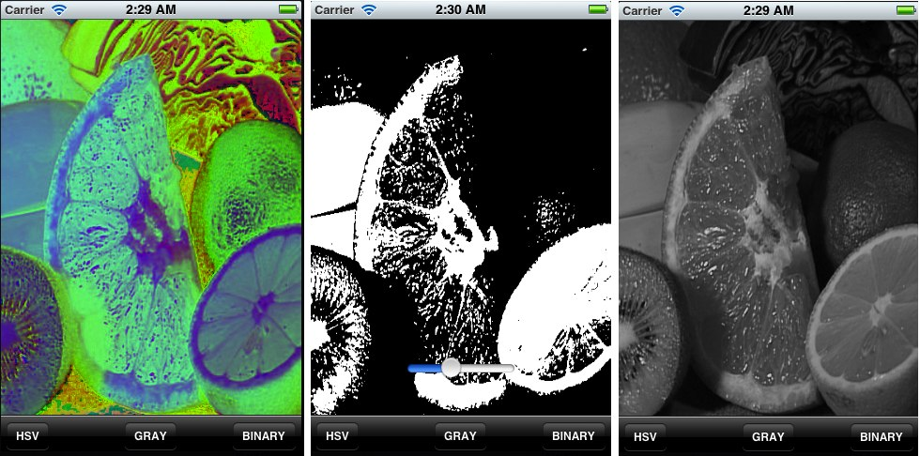
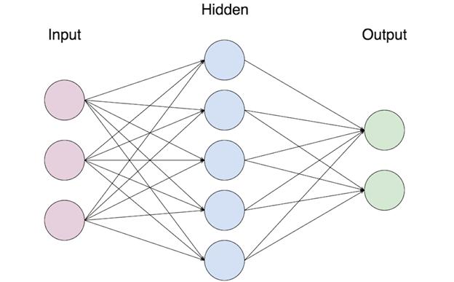
Tools and Technology used
Open CV library :- We are using 4.0.1 version of CV library. It is generally used for combining vision task.
CNN using Keras :- CNN is using for alphabet recognition.
Image Processing :- Frame is read and processed using image processing technique.
Python :- We use Python language as it has good collection of image processing libraries also it is used in open CV .
Open CV-Image Processing
Neural Network

Slide 11
Professional and Technical Learning
We will learn how to use deep learning and region based convolution neural network that are used in object tracking.
We’ll come to know about all the built in methods and operations of machine learning algorithms and how they can be used to achieve the goal of our project.
Professionally, we’ll be able to present our project to a mass group of people and make them understand how it’s working.

Slide 12
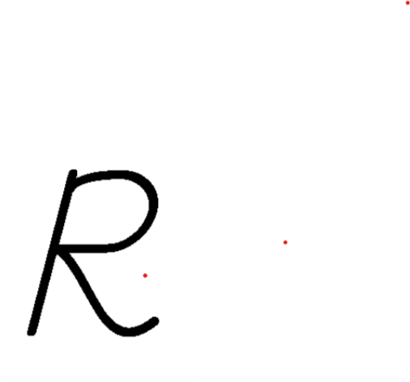
Insight into Working of Project
In our project, a frame is read from a webcam and an object placed on fingers is detected from this frame . We will get coordinates of the object.
From these coordinates, we will trace path on a white frame and this white frame will be shown to user so that user will only see alphabets drawn using gestures.

Slide 13
Contd..
For detecting frame from a live video in which an alphabet is complete we will use a time limit to draw an alphabet(say 5 seconds).
After that time limit, frame on screen will be fed to neural network to recognize an English aplhabet.
If that letter is recognized(say A) then picture of Apple wil be displayed on screen and audio file of “A for Apple” will be played.

Slide 14
Key Highlights of Project
This project mainly aims towards smart way of learning for the children. It enables the children to learn the fundamental alphabets with the application of technology.
This system would not only help the children to write the letters but also help them to learn how to pronunciate those alphabets.
This project is mainly based on the two significant branches of computer science field which is deep learning and object tracking technique.

